Slide 1
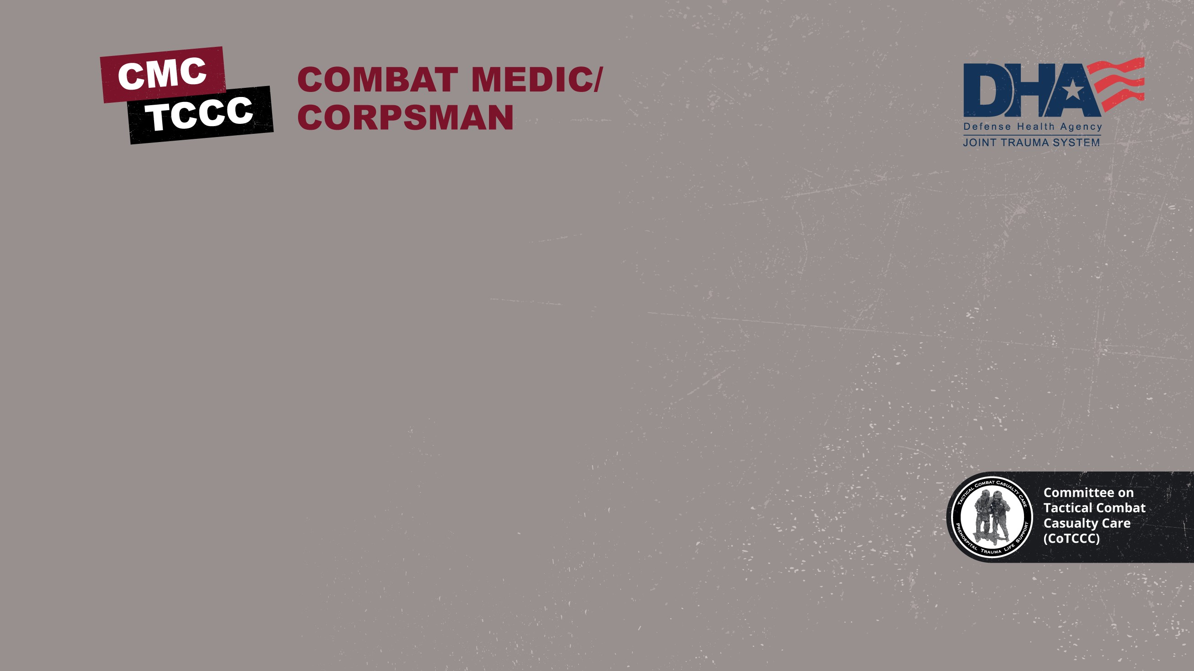

TACTICAL COMBAT CASUALTY CARE COURSE
MODULE 18: BURNS
Module 18: Burns
TCCC TIER 1
All Service Members
TCCC TIER 2
Combat Lifesaver
TCCC TIER 3
Combat Medic/Corpsman
TCCC TIER 4
Combat Paramedic/Provider

Slide 2
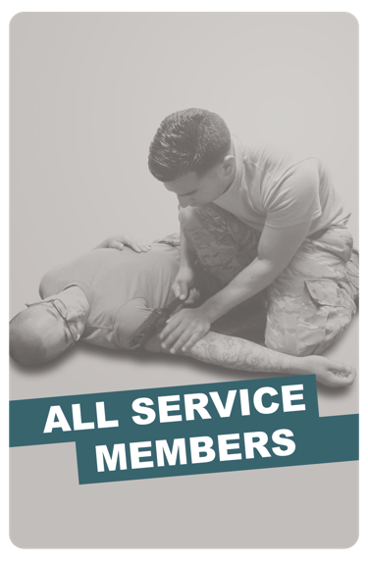
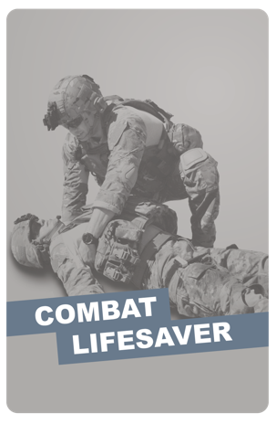
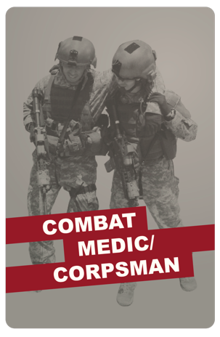
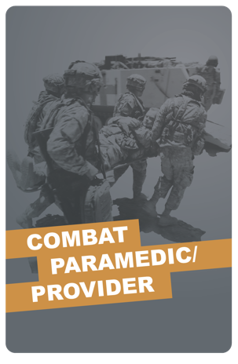
Module 18: Burns
TACTICAL COMBAT CASUALTY CARE (TCCC) ROLE-BASED TRAINING SPECTRUM
ROLE 1 CARE
NONMEDICAL PERSONNEL
MEDICAL PERSONNEL
YOU ARE HERE
STANDARDIZED JOINT CURRICULUM
2

Slide 3









1 x TERMINAL LEARNING OBJECTIVES
Module 18: Burns
21
Given a combat or noncombat scenario, perform assessment and initial treatment of burns during Tactical Field Care in accordance with CoTCCC Guidelines.
  Identify the specific scene safety issues and actions required of a trauma casualty with burns before evaluation and care of the casualty.
  Identify types and severity of burns in accordance with the conventional burn classification.
  Identify how to estimate the body surface area burned using the Rule of Nines.
  Identify the evidence supporting the indications, progressive strategies, and limitations for burn management in TFC.
  Demonstrate the application of a dry dressing to a burn casualty in accordance with CoTCCC Guidelines.
  Demonstrate techniques used to prevent heat loss in a severe burn casualty in accordance with CoTCCC Guidelines.
  Describe burn fluid resuscitation in Tactical Field Care.
  Identify the indications, contraindications, and administration methods of Lactated Ringer's in Tactical Field Care.
08 x ENABLING LEARNING OBJECTIVES
#
= Terminal Learning Objectives
= Cognitive ELOs
= Performance ELOs
3

Slide 4


Three PHASES of TCCC
Module 18: Burns
1
CARE UNDER FIRE (CUF)
/ THREAT
2
TACTICAL FIELD CARE (TFC)
WORK UNDER COVER AND CONCEALMENT
3
TACTICAL EVACUATION CARE (TACEVAC)
RETURN FIRE AND TAKE COVER
MORE DELIBERATE ASSESSMENT AND PRE- EVACUATION PROCEDURES
NOTE: This is covered in more advanced TCCC training!
YOU ARE HERE
4

Slide 5
MARCH PAWS
Module 18: Burns
LIFE-THREATENING
_{M} MASSIVE BLEEDING
#1 Priority
_{A} AIRWAY
_{R} RESPIRATION (Breathing)
_{C} CIRCULATION
_{H} HYPOTHERMIA / HEAD INJURIES
AFTER LIFE-THREATENING
P A
PAIN
ANTIBIOTICS
W
WOUNDS
S
SPLINTING
4

Slide 6

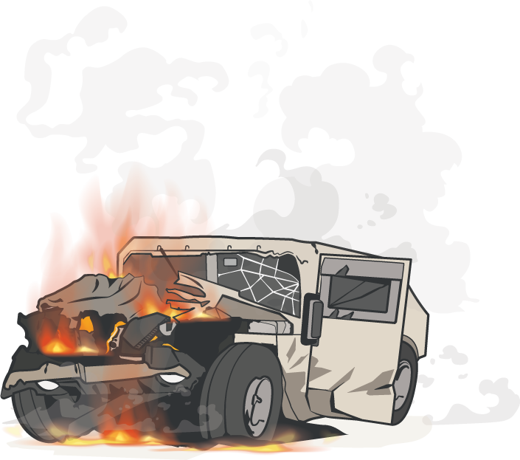
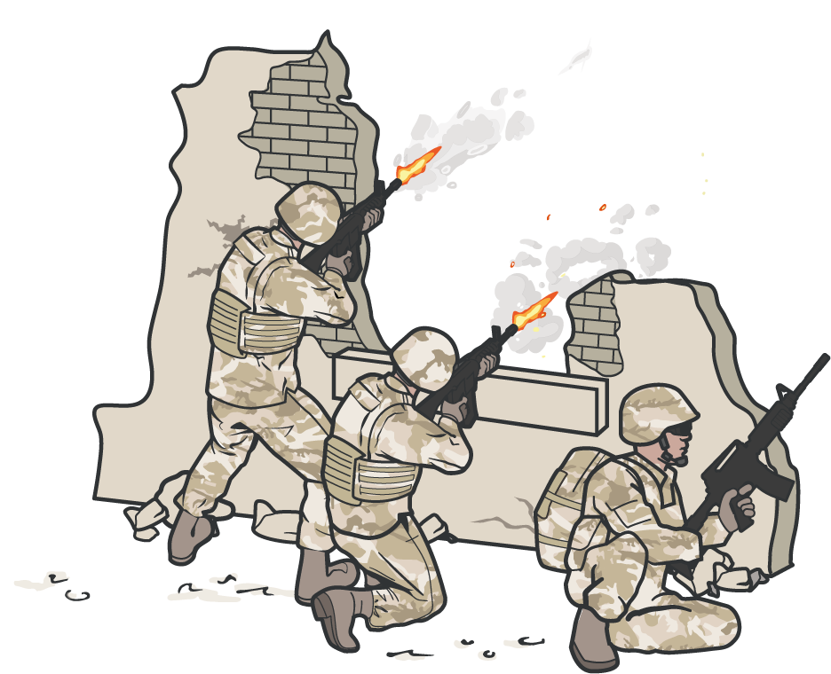
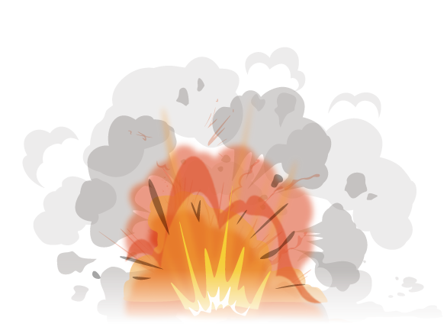


POTENTIAL CAUSES
Module 18: Burns
ELECTRICAL
THERMAL
FIREFIGHTS
EXPLOSION
IED / VBIED
VEHICLE/ AIRCRAFT CRASHES
CHEMICAL
P A
W
S

Slide 7
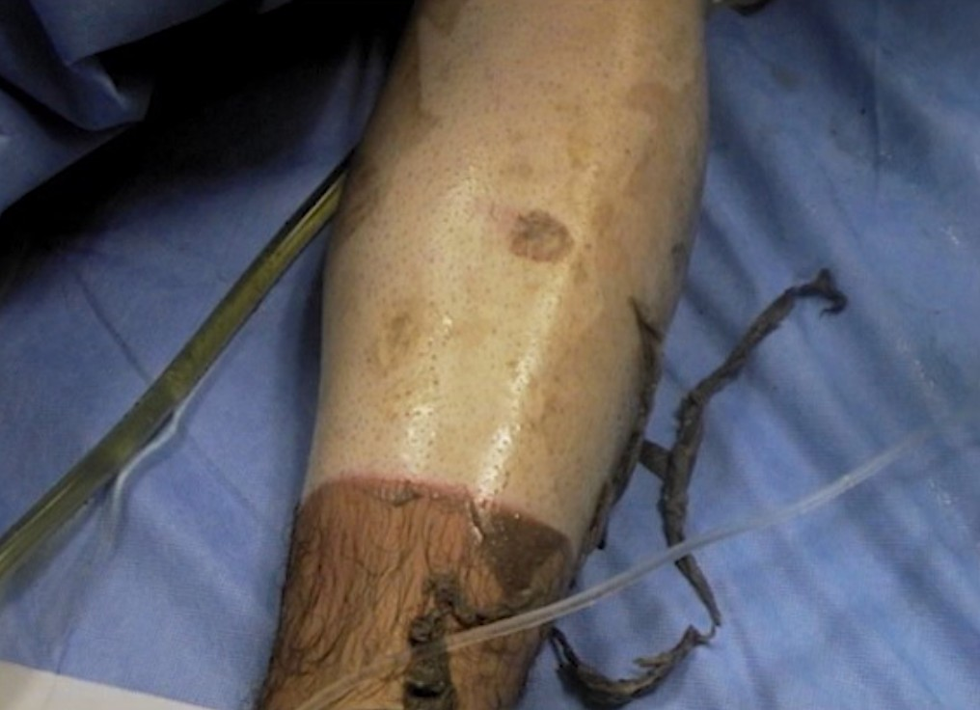
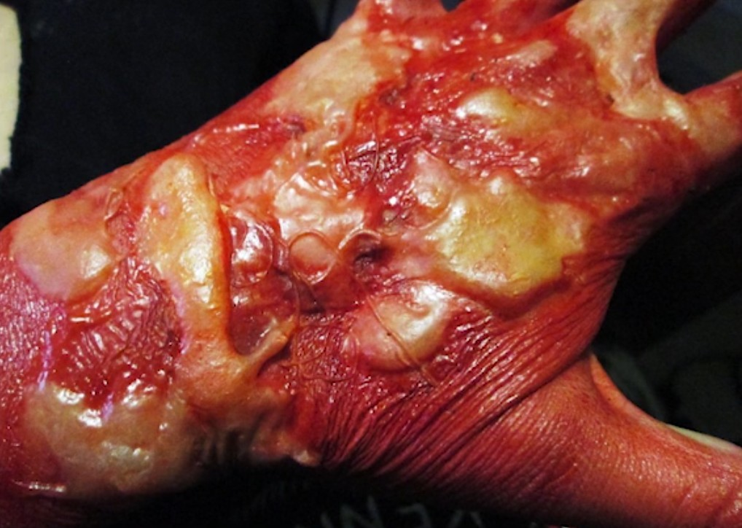
BURN WOUNDS
Module 18: Burns
BURN WOUNDS are an injury to skin or other tissues caused by heat, electricity, or chemicals and are present in 5% to 15% of combat casualties Burn patients have unique management challenges and considerations.
The combination of burn and non-burn injuries
results in a synergistic increase in mortality
The U.S. Army Institute of Surgical Research (USAISR) leads burn care efforts for the
U.S. military
Significant advancements in the care of burn casualties have been made in recent conflicts
P A
W
S

Slide 8
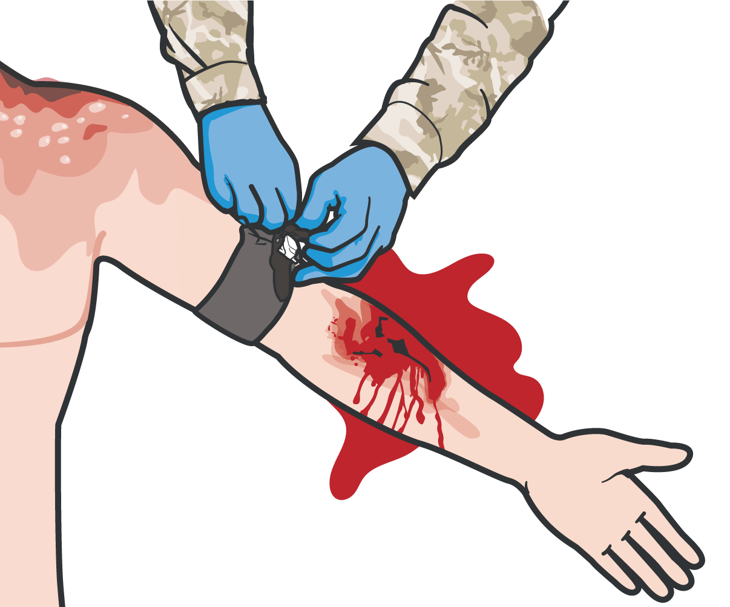

Module 18: Burns
FOLLOW MARCH PAWS
Address ALL OTHER life-threatening
injuries using the MARCH PAWS sequence
All trauma treatments can be performed on or through burned skin
Burn wounds may be distracting, but are unlikely to lead to immediate death
REMEMBER: A burned trauma casualty is a trauma casualty first!
Depending on the source of the burn special consideration must be taken when providing care
P A
W
S

Slide 9
Module 18: Burns
IN CASE OF ELECTRICAL INJURY
Secure the power, if possible
Otherwise, remove the casualty from the electrical source using a nonconductive object, such as a wooden stick
Move the casualty to a safe place
P A
W
S

Slide 10
Module 18: Burns
IN CASE OF THERMAL INJURY
STOP the sources of the burning
Assess and manage the burn, cut the clothing from around the burned area and gently lift it away
If clothing is stuck to the burn, ensure you cut around the clothing and leave it in place
Be sure to avoid grabbing or further damaging burned areas
P A
W
S

Slide 11
Module 18: Burns
IN CASE OF CHEMICAL INJURY
Advise all first responders of the presence of a chemical burn
EXAMPLE
WHITE PHOSPHORUS
SOURCE
Commonly found in tank rounds, mortar rounds, artillery rounds can cause burns
TREATMENTS
Submerse the burned area in water
Apply wet barrier (water-soaked gauze, clothing, mud, etc.) with an occlusive dressing
Patients with chemical burns should be deconned IAW Unit SOP
P A
W
S

Slide 12
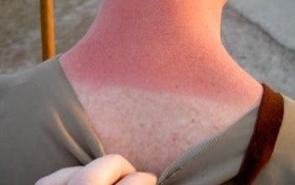
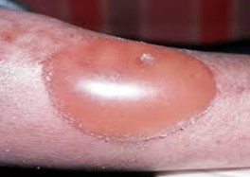
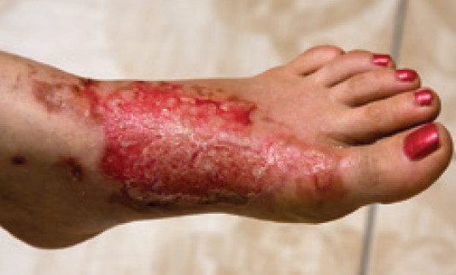
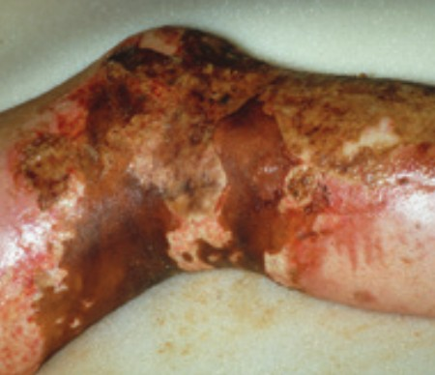
SEVERITY OF BURN
BURNS ARE CLASSIFIED BY THE DEPTH OF THE WOUND
Module 18: Burns
SUPERFICIAL
1ST DEGREE BURNS
These burns are painful and erythematous without blistering or open wounds. An example of a superficial burn is sunburn.
PARTIAL THICKNESS 2ND DEGREE BURNS
Bright red to mottled in appearance and wet to the touch. Blisters are commonly seen in superficial partial- thickness burns.
FULL THICKNESS 3RD DEGREE BURNS
May appear charred or whitish in color, dry, leathery, and insensate. Thrombosed blood vessels may be visible.
SUBDERMAL BURN 4th DEGREE BURNS
Subdermal burns extend through subcutaneous tissue into fascia, muscle, and even bone.
P A
W
S

Slide 13
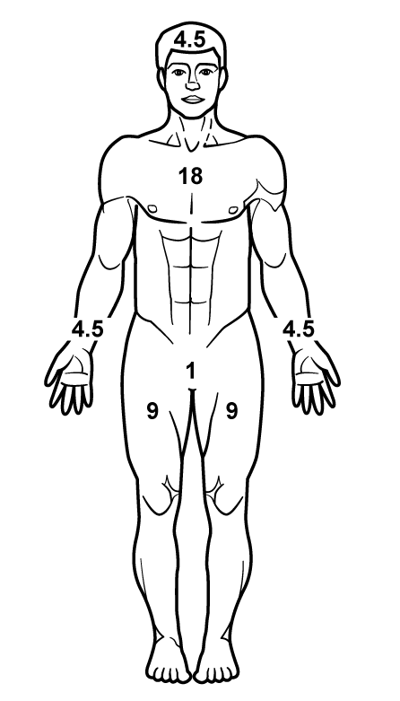
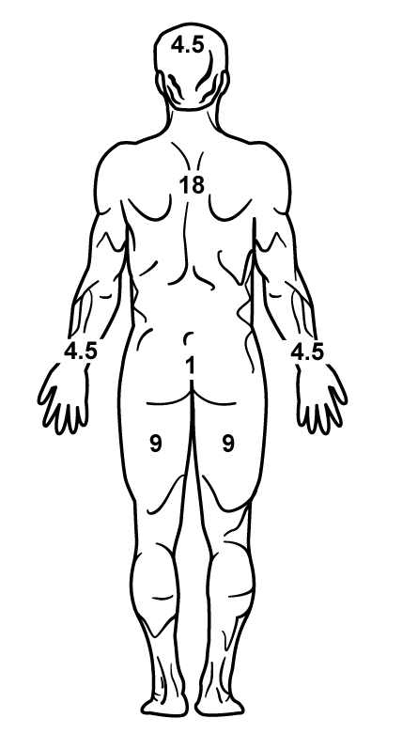
RULE OF NINES
Module 18: Burns
11 areas that each have 9% body surface area (head, upper extremities, front and backs of lower extremities, and front and back of the torso having TWO 9% areas)
Palm size represents ~1%
Estimate/round up to nearest 10%
If half of the front or rear area is burned, the area would be half of the area value
Estimation Example:
Half of the front upper/lower extremity is 4.5% Half of the front upper/lower torso is 9%
DO NOT include first-degree burn in this assessment.
P A
W
S

Slide 14


CALCULATING RULE OF NINES
Module 18: Burns
Burned areas:
9%
9%
9%
Left half of anterior torso
Front and back of left upper extremity Anterior portion of left lower extremity
= 27%
(9%+9%+9%=27%)
Total Body Surface Area (TBSA) Burned
Note: For estimation of fluid resuscitation requirements this would be rounded up to 30%
P A
W
S

Slide 15
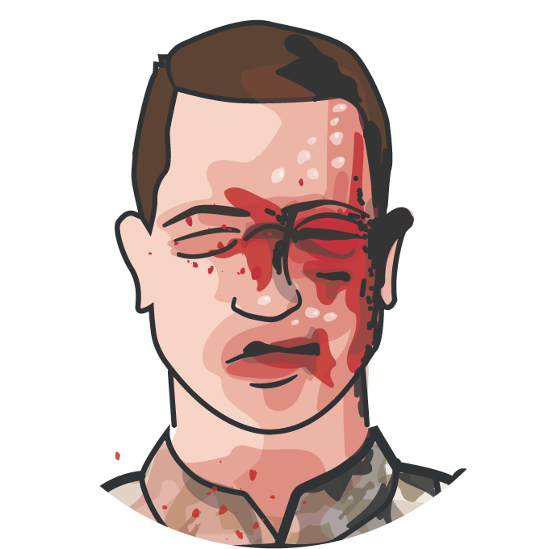
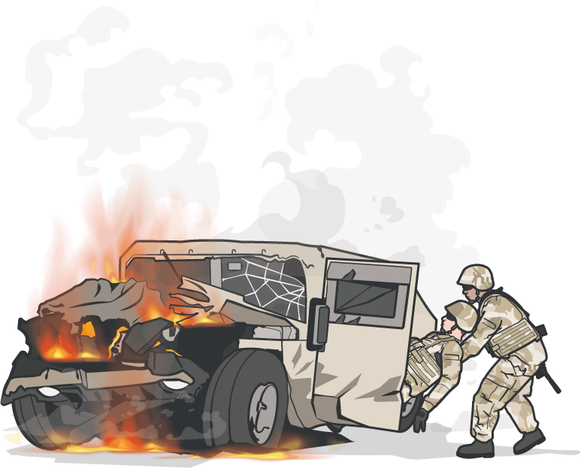
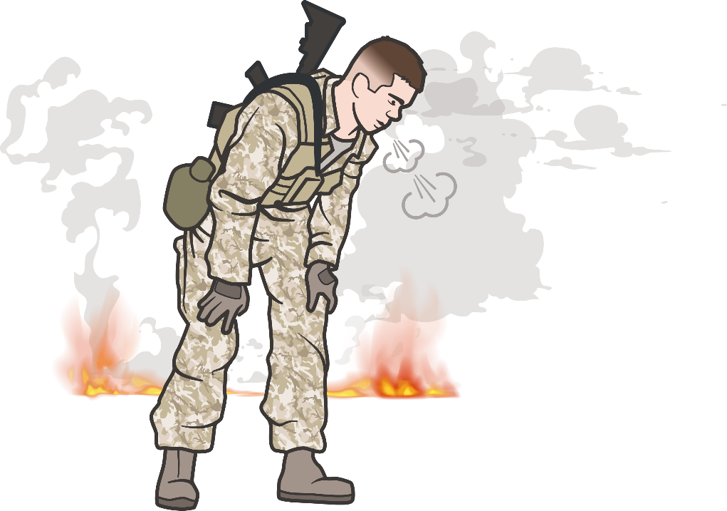
AIRWAY
Module 18: Burns
STOP the burning process!
Inhalation injury can cause difficulties with the airway and breathing
Findings suggestive of inhalation injury include facial burns, carbonaceous sputum, stridor, hoarseness, or cough
Inhalation injury should be suspected if the casualty was in an enclosed space such as a vehicle, a building, or a burning compartment in a ship at sea
P A
W
S

Slide 16
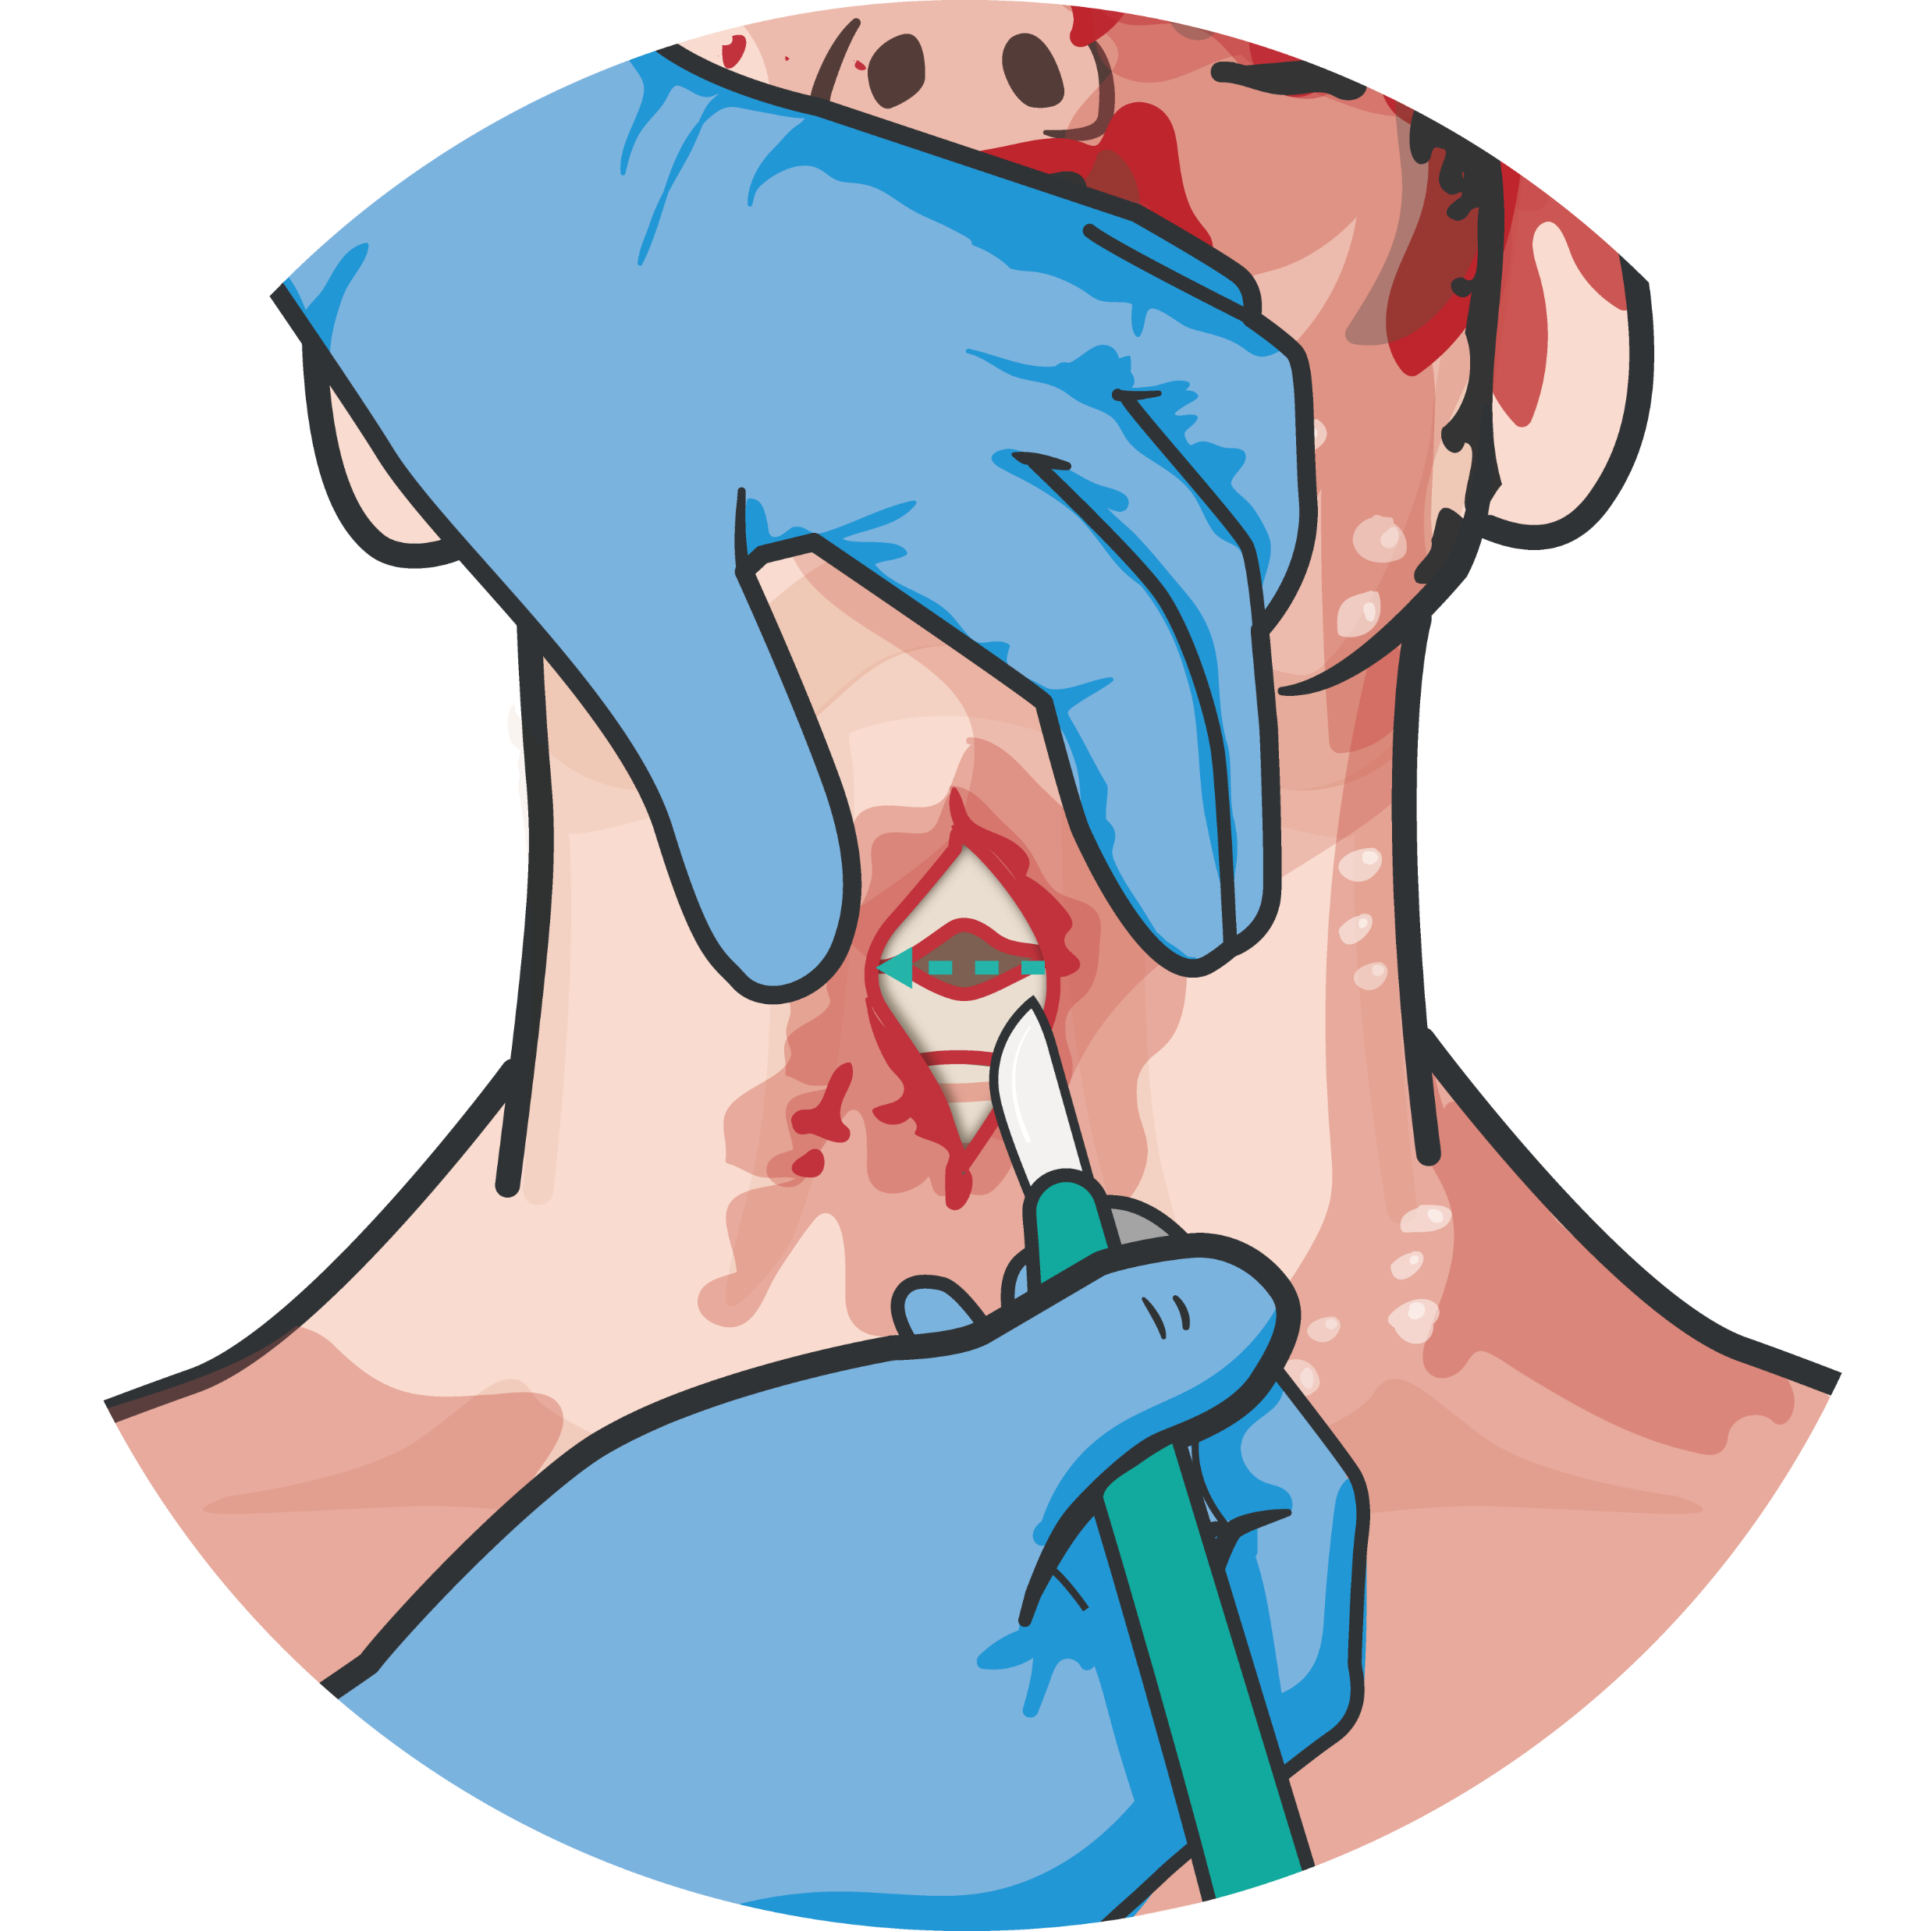
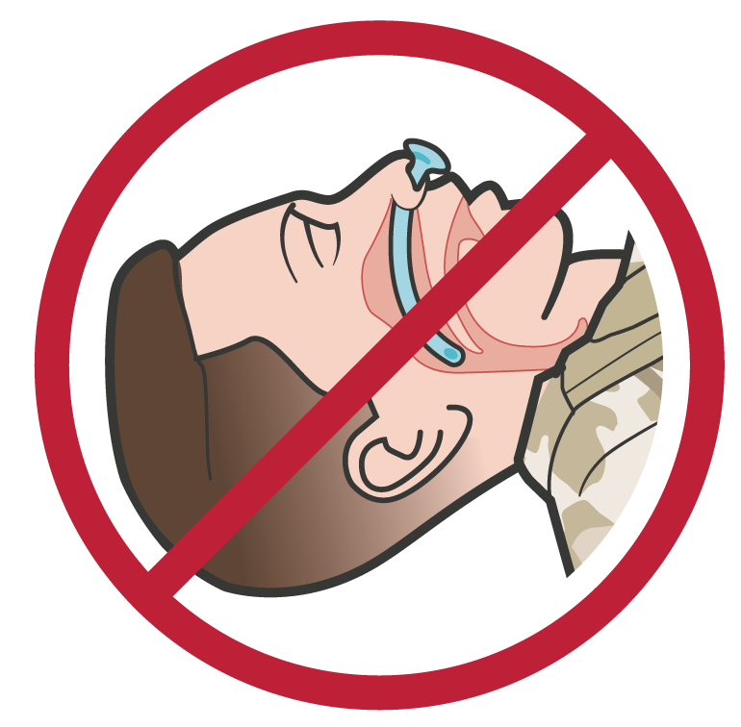
AIRWAY
Module 18: Burns
Facial burns, especially in closed spaces,
may be associated with INHALATION INJURY
Aggressively monitor airway status and oxygen saturation in such patients and consider early surgical airway for respiratory distress or oxygen desaturation
Nasopharyngeal airways and extraglottic airways may not suffice and a surgical cricothyroidotomy may be required
DO NOT place NPA or extra-glottic airway in casualty with signs of suspected inhalation injury
P A
W
S

Slide 17
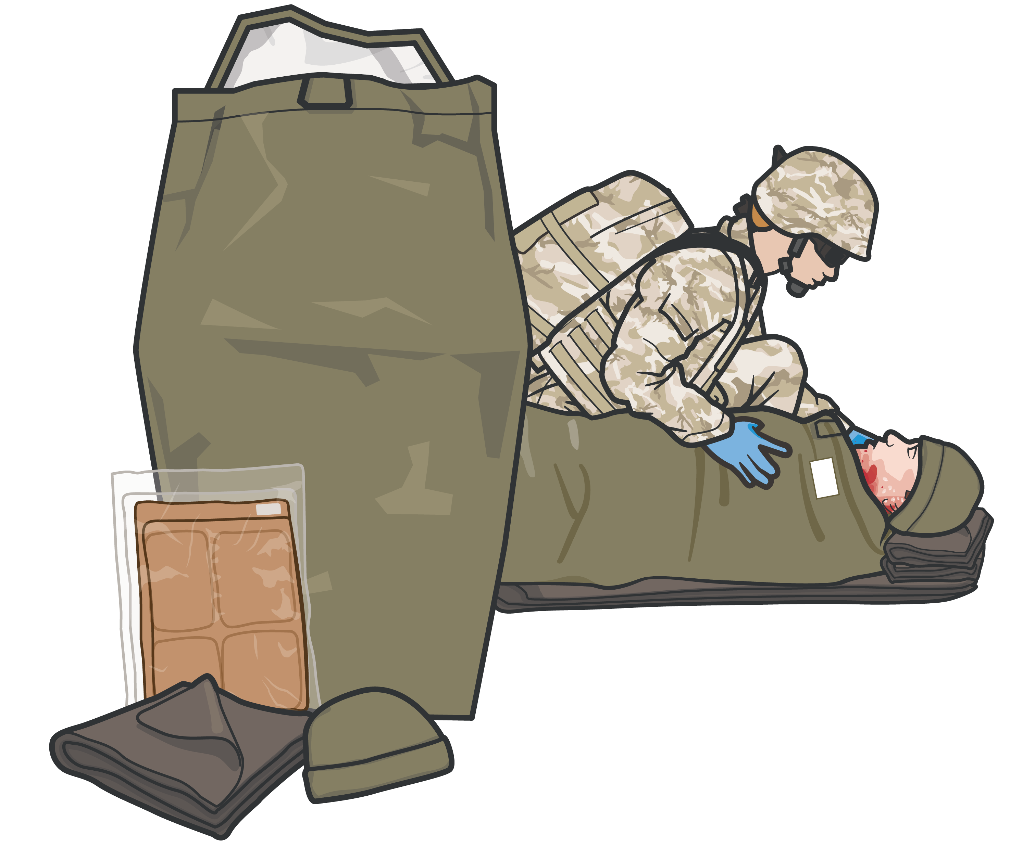
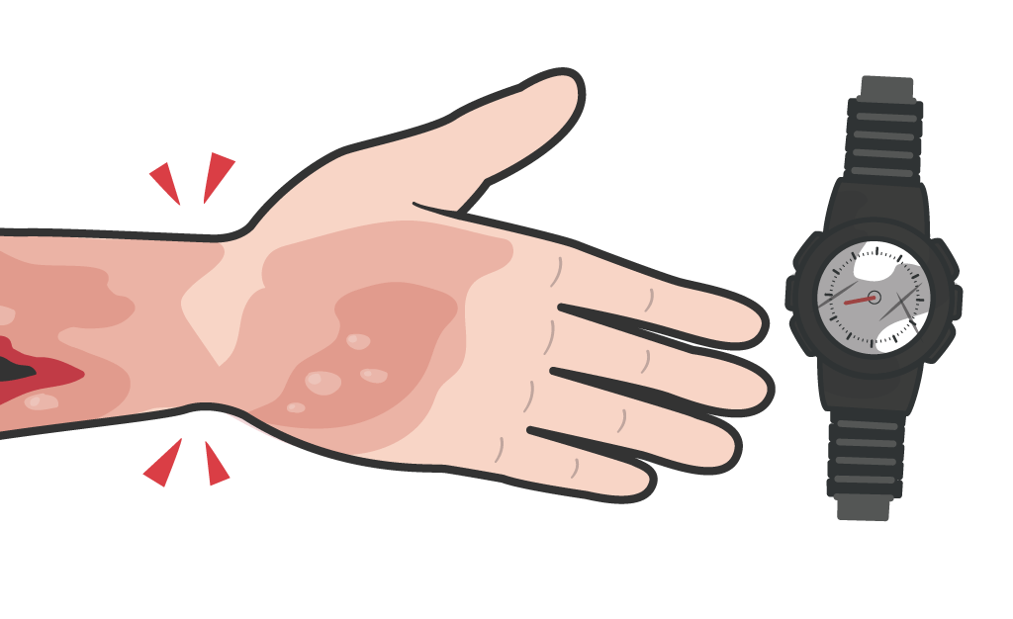
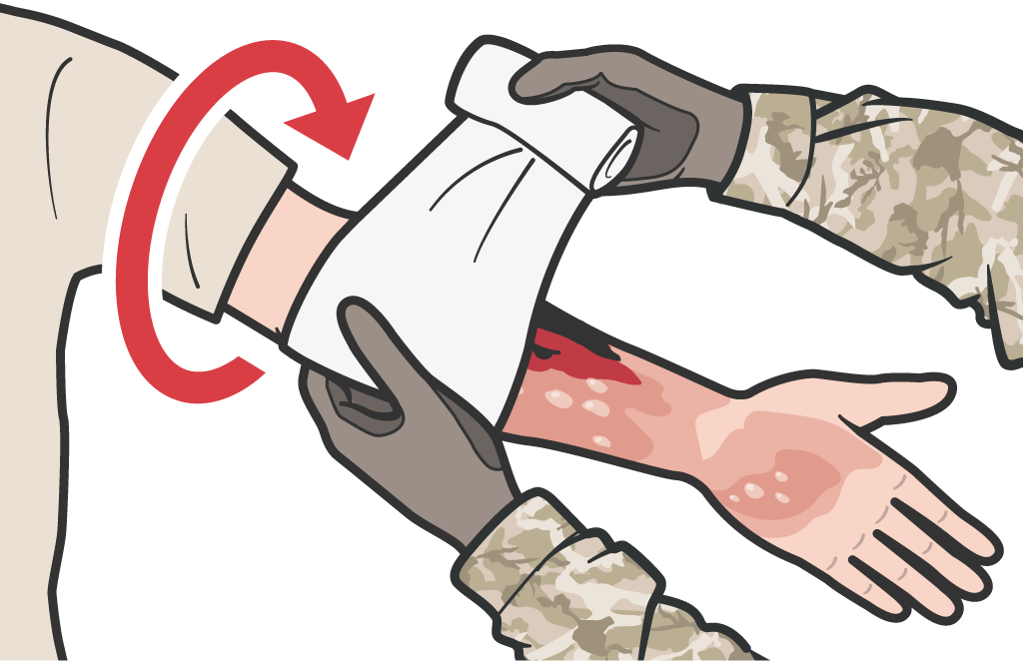
Module 18: Burns
BURN CARE
REMOVE watches and jewelry from burned area
COVER the burn area with dry, sterile dressings
ACTIVE/PASIVE HYPOTHERMIA PREVENTION
For extensive burns (>20%), place the casualty in a Heat-Reflective Shell or Blizzard Survival Blanket in order to cover the burned areas and
P A
W
S
prevent hypothermia

Slide 18
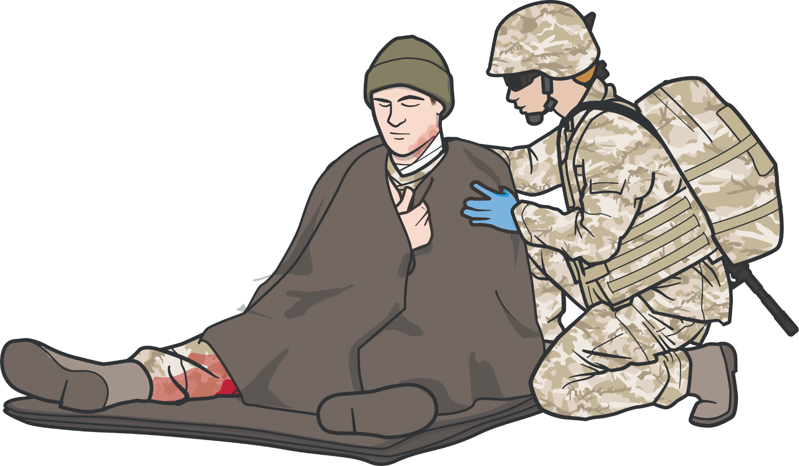
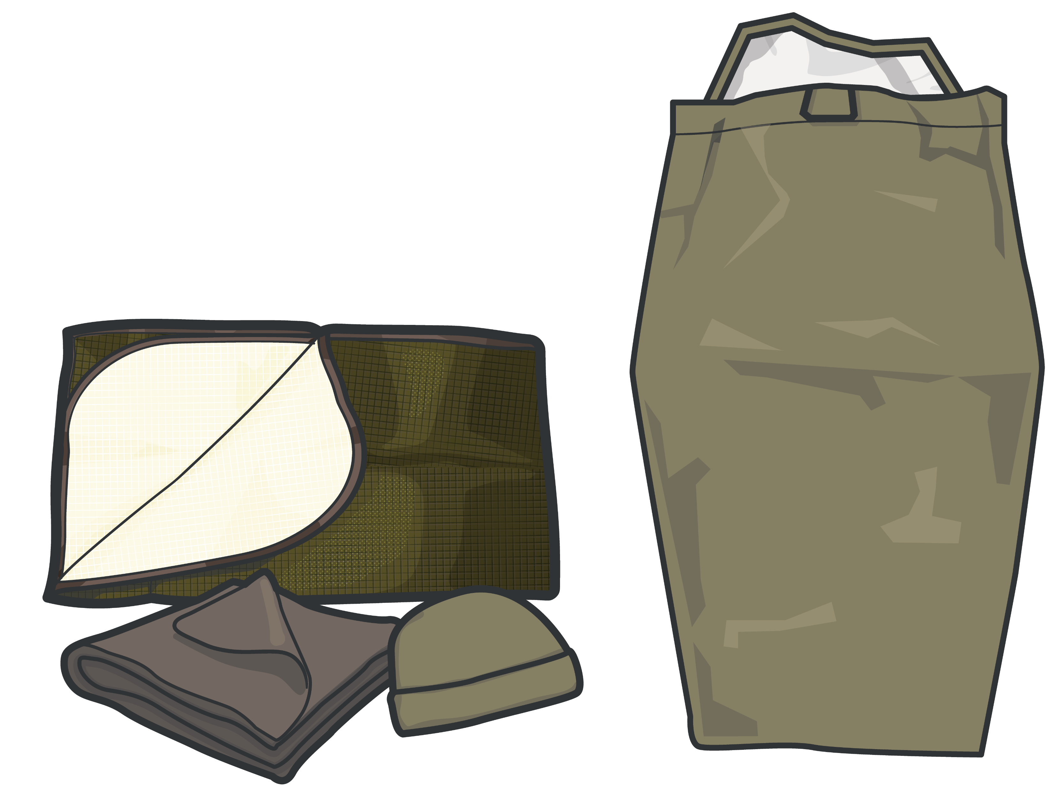
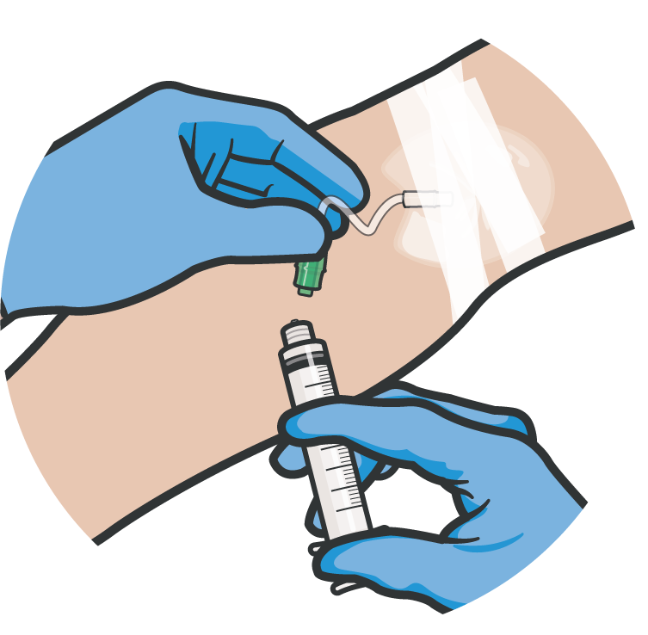
BURN CARE AND HYPOTHERMIA PREVENTION
Module 18: Burns
For extensive burns (>20%), consider using active warming supplies to cover the burned areas and
prevent hypothermia
PASSIVE
Warming Supplies
Analgesia may be administered to treat burn pain
Antibiotic therapy not indicated solely for burns
Burn patients are particularly susceptible to hypothermia
Extra emphasis should be placed on barrier heat loss prevention methods
P A W S
18

Slide 19
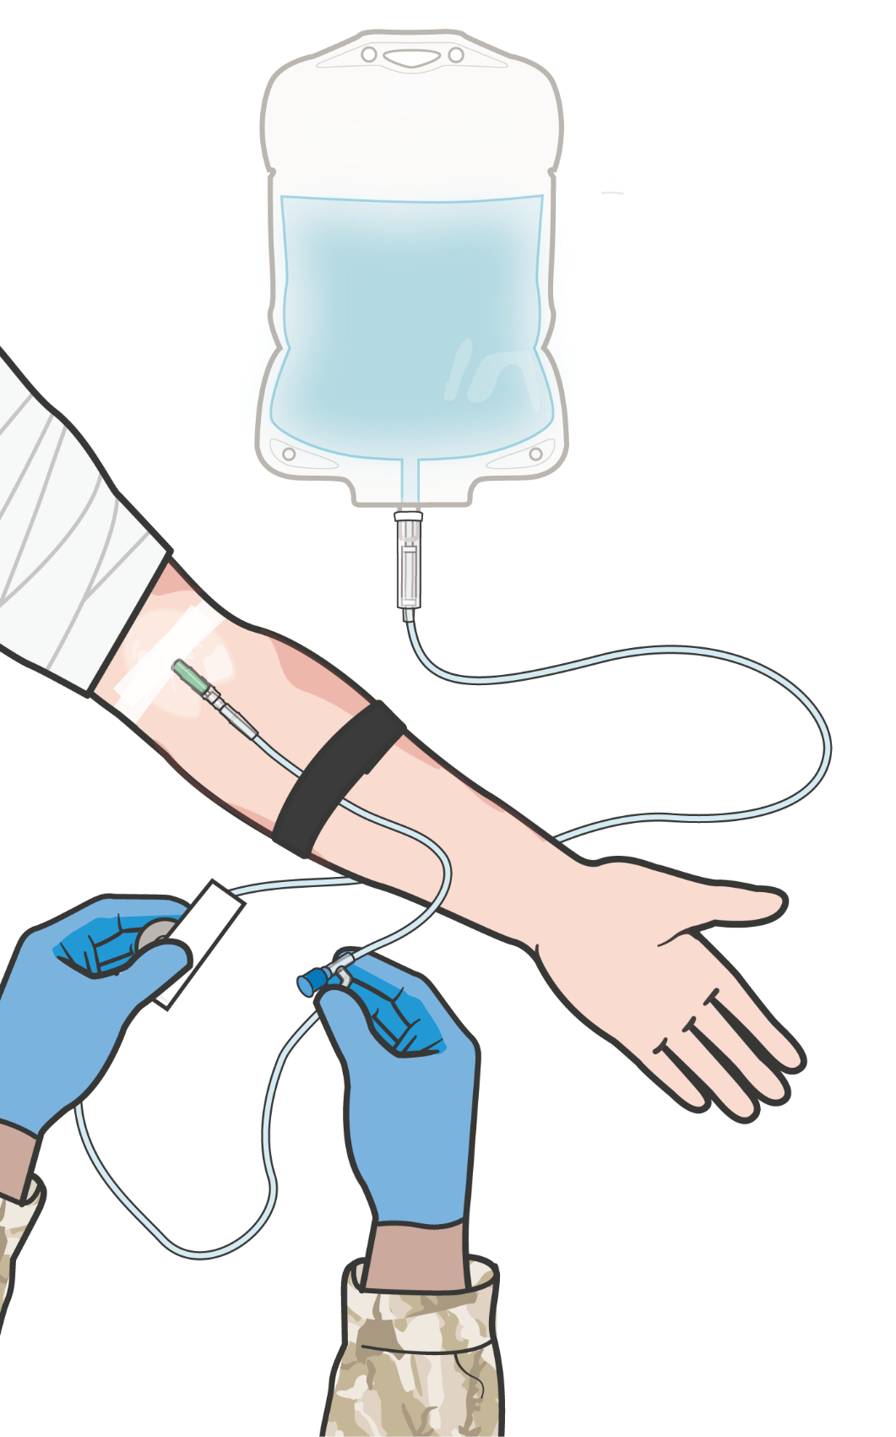

BURN FLUID RESUSCITATION
Module 18: Burns
Fluid resuscitation for burn casualties is guided by the
USAISR Rule of Ten
For burns > 20% TBSA, initiate fluid resuscitation as soon as IV/IO access established
REMEMBER: If hemorrhagic shock is also present, resuscitation for hemorrhagic shock takes precedence over resuscitation for burn shock
Use Lactated Ringer’s, normal saline, or Hextend®
(If Hextend is used, no more than
1000 ml should be given, followed
by Lactated Ringer’s or normal saline as needed)
Initial IV/IO fluid rate is %TBSA x 10 ml/hr for adults 40-80 kg
For every 10 kg ABOVE 80 kg, increase initial rate by 100 ml/hr
Consider using oral fluids for burns up to 30% TBSA if casualty is conscious and able to swallow
P A W S

Slide 20

SKILL STATION
Module 18: Burns
Burn Treatment (Skill)
Burn Dressing

Slide 21
SUMMARY
Module 18: Burns
Treatment priorities in trauma and burn casualties Airway considerations in burn casualties Potential causes of burns
Types of burns (Electrical, Thermal, and Chemical) Severity of burn injuries according to depth Estimating burn size with the Rule of Nines
Fluid Resuscitation with the USAISR Rule of Ten
Prevention of hypothermia in burn casualties
P A W S

Slide 22

CHECK ON LEARNING
Module 18: Burns
What kind of dressing should be placed on burned areas?
What should you do first when you encounter a casualty with an electrical burn?
What should you do first when you encounter a casualty with a thermal burn?
What percentage TBSA requires fluid resuscitation?
What would be the fluid infusion rate for a 90 kg person with a 40% burn according to the USAISR Rule of Ten?

Slide 23



ANY QUESTIONS?
Module 18: Burns

Slide 24
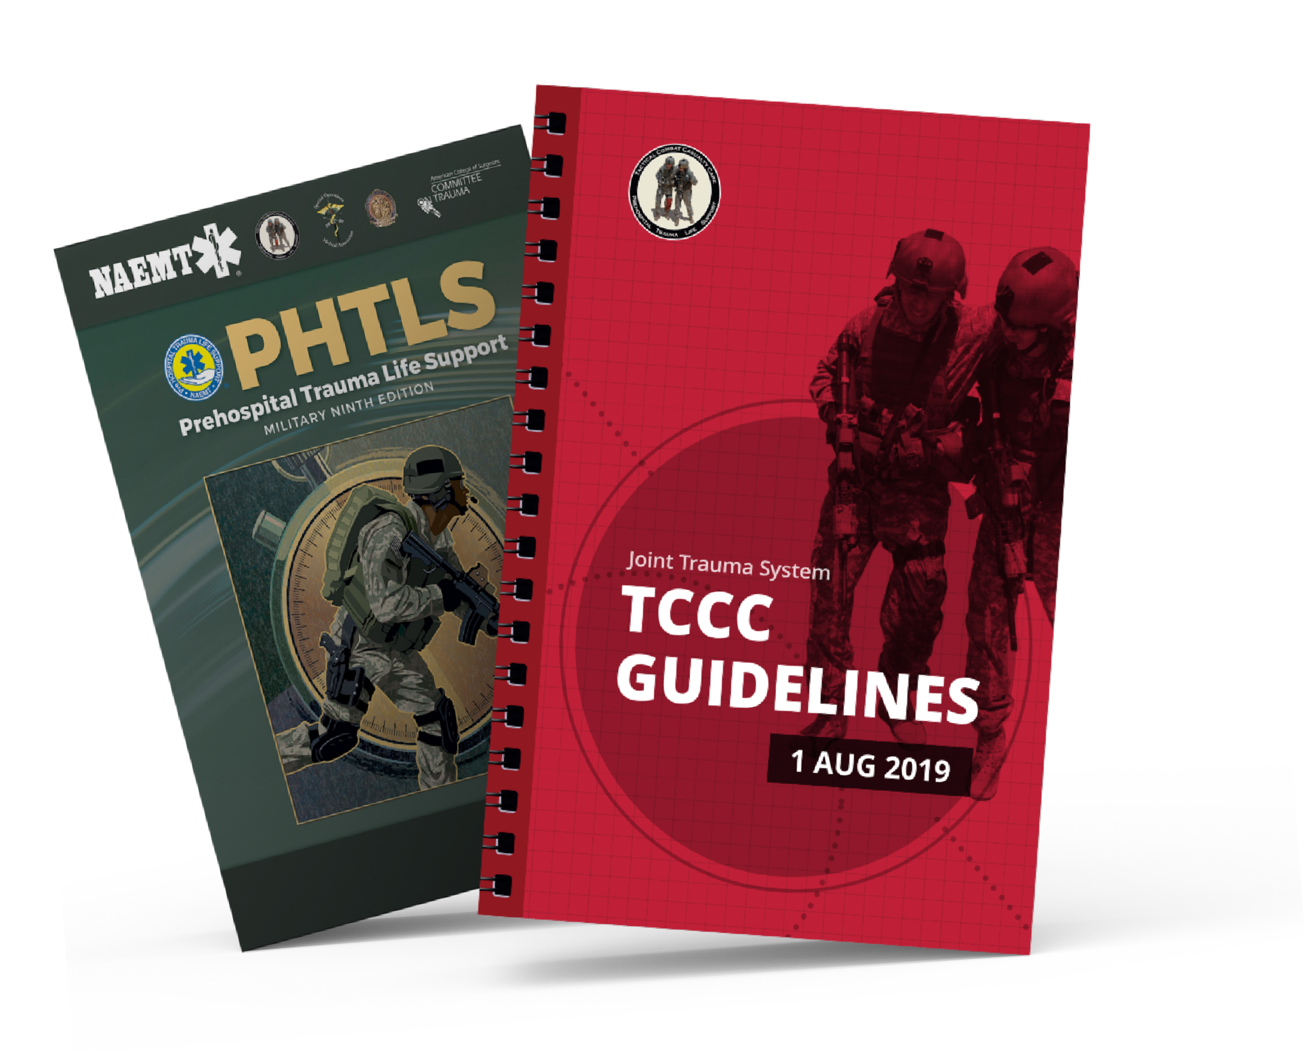
REFERENCES
Module 18: Burns
TCCC: Guidelines
by JTS/CoTCCC
Updated regularly – latest edition dated 5 November 2020
These guidelines are the result of decisions made by the Committee on Tactical Combat Casualty Care as they explore evidence-based research regarding best practices
PHTLS: Military Edition
by NAEMT
Prehospital Trauma Life Support, Military Ninth Edition
NOV 2020

